Slide 1

Marketing HW1
Dashevskiy Vladimir, Tarasova Sofia, Sadykova Darya

Slide 2
01
Data preparation

Slide 3
Cleaning data
Feature engineering (aggregation on user)
Not all of those features were used in the final clusterization, we reduced the dimensionality after testing
Dropped rows with null user_id
Checked user_id for uniqueness in the customer data
Checked for outliers in the features using three sigma rule
Filled outliers in age (for example users who are 221 year old)
Count/sum/avg of transactions overall and for difference time periods (last 7/30/180 days)
Difference in transaction amount between time periods
Non-transactional features: days since last visited/days active, flag of living in the capital, top 1 or 2 MCC per user, etc

Slide 4
02
Cohort Analysis

Slide 5
Methodology:
Cohort were calculated by the minimum date of transaction
Periods were the following months after the first transaction date
We included only generations from 2020-01-01 to 2020-12-01 (because the dataset slice originated from that date)
Those generations were grouped together because of non statistically relevant counts

Slide 6
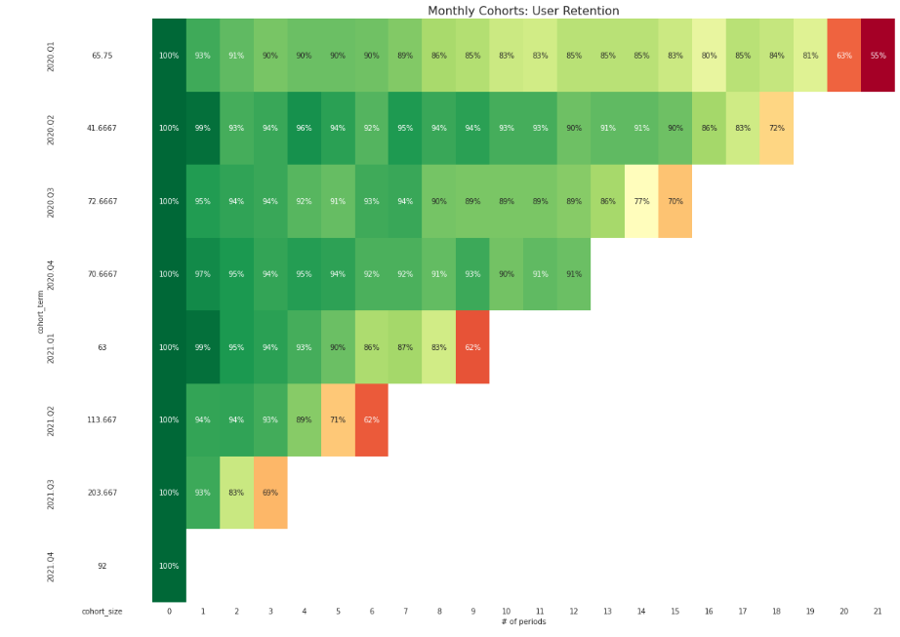

Slide 7
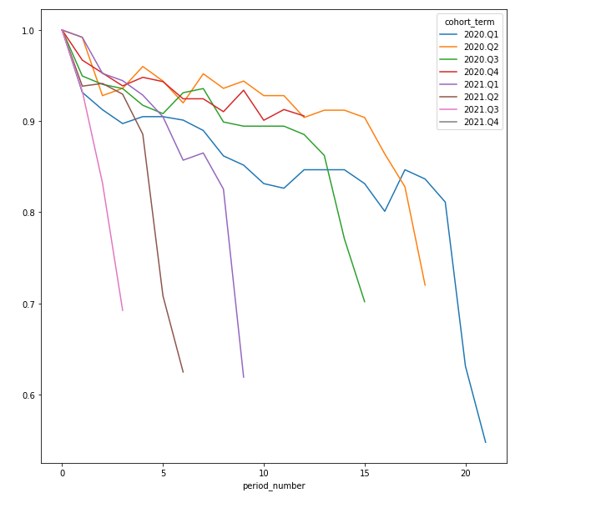

Slide 8
Conclusion:
as we can see, something has changed in 2021Q1
retention rate started to increase, as we get to 60% at quicker rates
probably at has to do something either with our product (e.g worse cashback options, which stimulates customers)
or with ineffective CRM campaigns as well as acquisition channels (maybe we ran out of loyal customer segment)

Slide 9
04 Clusterization

Slide 10
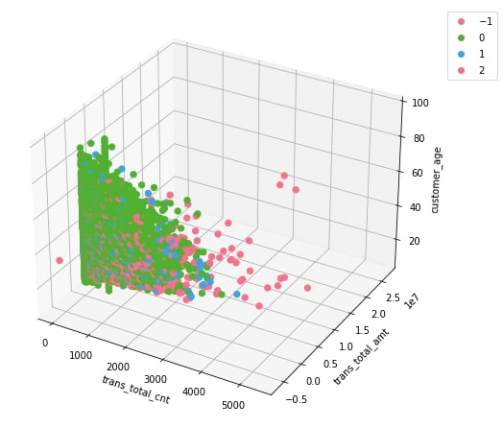

Slide 11


The most old people, do not have app, therefore do not have push, transaction amount and count is small, are the oldest in terms of registration
People, who have app, but not push, transaction amount and count average
The youngest people, have both app and push, spend the most, are new customers by registration (compared with others)

Slide 12
05
KPI

Slide 13
1 cluster (old, non-active)
Ratio of apps installed increased
2 cluster (middle in all areas)
Ratio of push turned on increased
3 cluster (young active, money spending)
Total profit increased
Recency
Frequency
Monetary

Slide 14
06
Hypothesis

Slide 15
Methods
We used two non-parametric tests because our data is not normally distributed: Kruskal-Wallis test and Mann-Whitney U test.
We used two in order to test the consistency of results because non-parametric test can be less accurate.

Slide 16
We tested three hypotheses:
People who turn on push notifications spend more money on our platform.
People with app installed and pushes on are generally younger that those without the app
People who turn on push notifications are more active: days since they visited is less for them.
All of those hypotheses proved to be statistically significant.

Slide 17
06
Marketing strategy

Slide 18
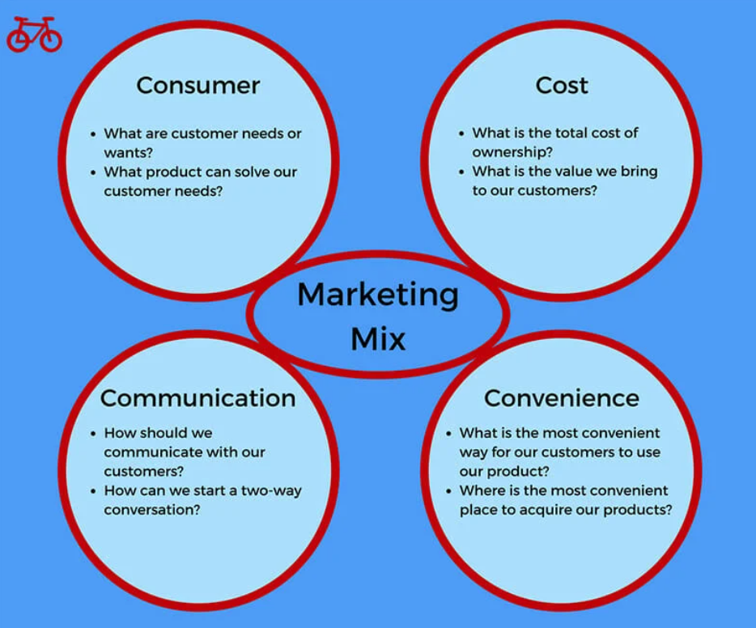
We decided to use 4C framework in order to develop our marketing strategy:

Slide 19
Unfortunately, we do not know much about much Cost (we can’t compare it to other competitors)
As for Customer needs - the most popular MCC code for transaction was Products. Combining this fact with our hypothesis we developed these market strategies for clusters:

Slide 20
1 Cluster:
As we know, this category of clients do not have the app. There is a correlation between customers transactional behaviour and acquiring an app.
Therefore our strategy is to increase usage of an app in this category of clients. How can we do this? Probably, this clients are not technically apt, ergo we need to educate them (promote app via our employees, make simple tutorial)

Slide 21
2 Cluster:
This category of clients do not have push notifications. There is a correlation between customers transactional behaviour and pushes
Therefore our strategy is to promote usage of pushes in app. We have to analyze, why do these clients not want to use pushes (maybe there are too intrusive or about discounts which are not interesting to our clients).
Also we can switch channel of pushes - use email, SMS, telemarketing, so we increase their involvement.

Slide 22
3 Cluster:
Though, comparing to other clients, this segment is quite profitable - they have our app, notifications and they spend a lot, we still can increase their spending behaviour.
As it turned out, the most popular categories of purchases are products, transport. Therefore, for these clients we have to promote more interesting cashback in these categories, make partner relationships with such trading companies.

Slide 23
Thank you for your attention!!

